Slide 1

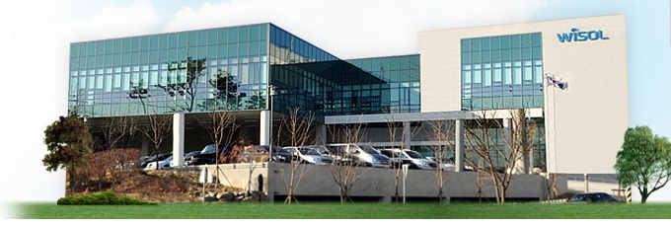
WiSOL Company Profile
www.wisol.co.kr
Wireless Solution leading ubiquitous frontier

Slide 2


Meaning of CI
The Overall shape embodies a blossomed flower
1. Three Ovals mean internal customers, external customers and affiliated companies.
2. Three Ovals meeting at the end of L letters means the three develop together.
3. The Opening of the end of L letter means WISOL pursues eternal value
4. Small Icon of the on alphabet I means wireless solution
Wireless Solution
WISOL seeking eternal value
Internal customers
External customers
Affiliated companies

Slide 3

Profile
CEO | JI-HO, KIM
Established | 20th of June, 2008
Location | 28-40, Gajangsaneopdong, Osan-si, Gyeonggi-Do, Korea
Employee | 1,142( KOREA 502, CHINA 500, VIETNAM 140 )
Home page | www.wisol.co.kr
Product | RF Biz Unit : SAW filter / Duplexer / FEMiD / GPS LNA Module
 | CM Biz Unit : Wi-Fi / Bluetooth / NFC / ZIGBEE / Z-WAVE Module

Slide 4

History
2008 | JUN SEP |  | Establish WISOL co. Ltd. ( Capital US$300,000 ) Spin off from SEMCO for “SAW Filter “
2009 | JAN MAR |  | Establish WISOL China( Tian-Jin ) Registered as SAMSUNG’s 1st supplier (MC Biz Unit )
2010 | SEP DEC |  | IPO ( KOSDAQ ) Listed ( Capital US$ 5,000,000 ) Build WISOL HQ ( Osan-si, Gyeonggi-do, KOREA )
2011 | JAN DEC |  | Starting Connectivity Module Biz for TV (Bluetooth/ZigBee/WiFi Module ) Sales Revenue US$100,000,000
2012 | MAR OCT |  | Build 3rd Plant at Osan Starting SAW Filter Module (RSM) for Smart phone
2013 | SEP |  | Starting Wi-Fi /BT Combo Module ( SIP ) for Smart phone
2014 | OCT |  | Module Maker Partnership for IoT with Qualcomm
2015 | JUL AUG |  | Start to produce at WISOL HANOI in Vietnam Start to build 4th Plant at Osan (FAB 2nd Plant) – Est. MAR of Y2016

Slide 5
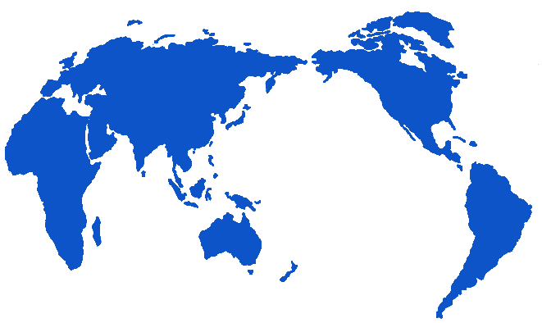
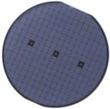

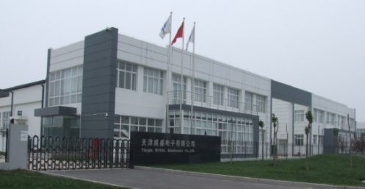

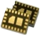
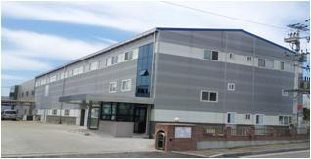
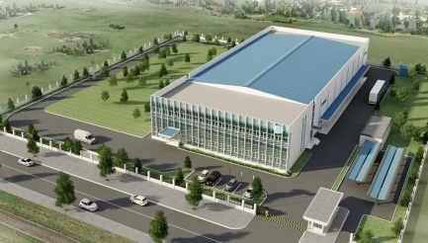
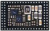
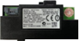
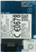
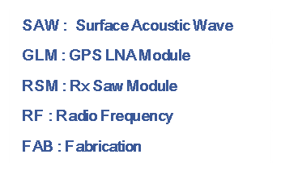
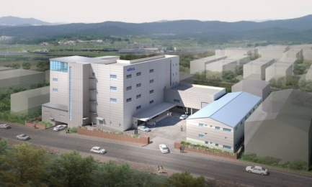
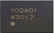
Location - R&D/Plant
CHINA(TIAN-JIN)
KOREA (OSAN)
CHINA
HQ
SAW Filter
- R&D Center
- FAB Line
R&D
R&D reserch
- Wi-center
- QC
- New Project
Incubator
SAW Filter
RF Module
VIETNAM
Zigbee
The 3rd Plant
RF Module Line
- GLM/RSM/SiP
- Wi-Fi /Bluetooth
ZigBee
RF Module Line
-GLM/RSM/SiP
-Wi-Fi /Bluetooth
ZigBee

Slide 6
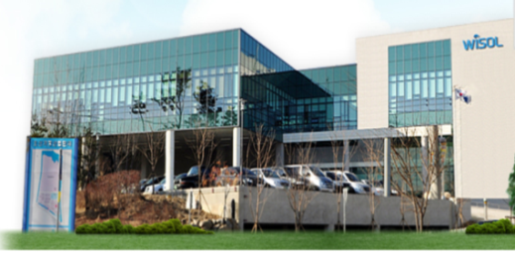
Location - SALES
CHINA
KOREA
TIAN-JIN
HQ ( OSAN )
Xian Sales Office
Sales Office ( Seoul, Suwon )
Shang-Hai Sales Office
Shen Zen Sales Office

Slide 7
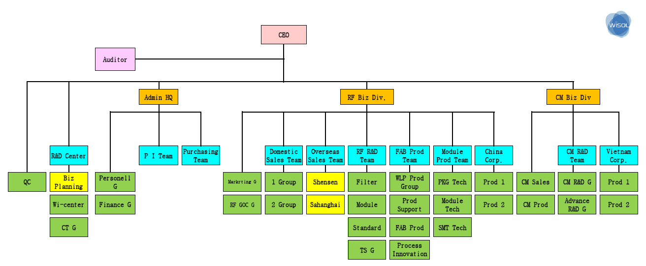
Organization
 | TOTAL | R&D | Engineer | QC | Product | SALES | ADMIN | Other
Korea | 502 | 76 | 43 | 32 | 272 | 27 | 45 | 7
China | 500 | 12 | 69 | 51 | 317 | 18 | 33
Vietnam | 140 |  | 20 | 9 | 92 | 2 | 15 | 2
Total | 1,142 | 88 | 132 | 92 | 681 | 47 | 93 | 9

Slide 8

Sales Revenue
Sales Growth ( Total ) [ Unit : M USD ]
CAGR 44.6%
◈ Stands for
RF : Radio Frequency
CM : Connectivity Module
[Million $]
 | Y2008 | Y2010 | Y2012 | Y2014 | Y2015 | Y2016(E) | Y2018(E)
RF | 25 | 62 | 83 | 160 | 230 | 350 | 650
CM |  |  | 32 | 70 | 90 | 150 | 350
WISOL | 25 | 62 | 115 | 230 | 320 | 500 | 1,000

Slide 9
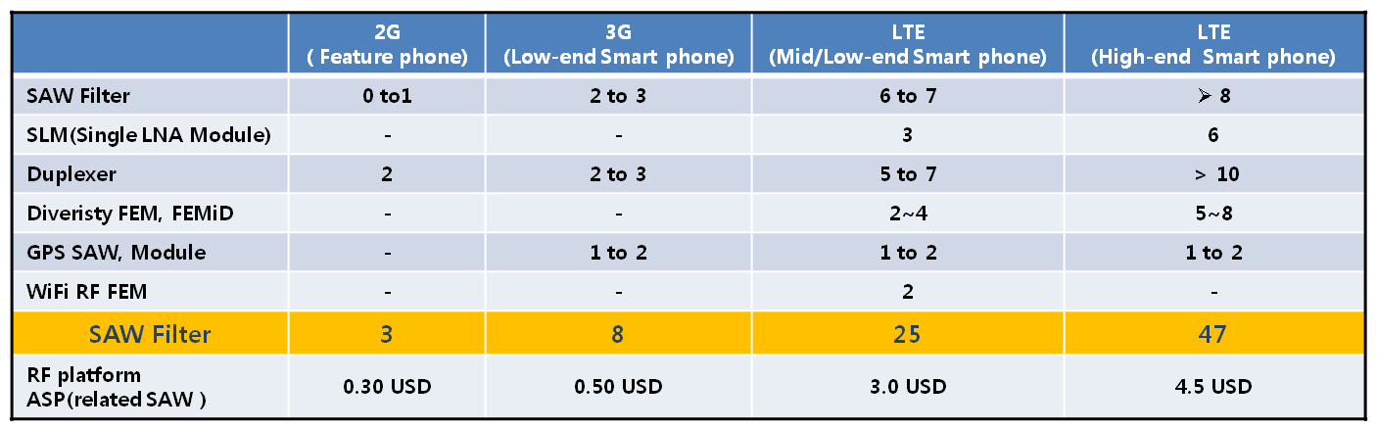
Sales Revenue
[ SAW Market Demanding is keep increasing ]
LTE Mobile Phone portion of Total Smartphone has been increased
( Although Total Smartphone market is hold up)
Due to LTE Roaming, The Number of the Supporting BAND has been increased
Due to Metal design & Enhanced Antenna, add more RF parts ( LNA and etc ) and Modularized
[SAW Filter Demand for each Smart Phone]

Slide 10
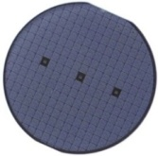
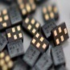
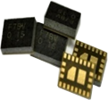
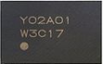
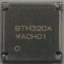
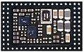
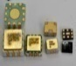
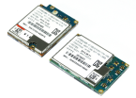
Capability
WiSOL has
3G/LTE, Wi-Fi / Bluetooth ( + smart ) / ZigBee / Z-Wave / NFC / PLC Connectivity Module Design Techniques
and Production available now.
Based on SAW, has Ceramic / Dielectric / Magnetic body parts and the high level of the Packaging Design and Manufacturing skills for downsizing.
RF
CM
GLM/ Diversity FEM /FEMiD
SIP Type
Connectivity Module
PBA Type
Connectivity Module
SAW Filter/DPX
Product
Current
500M/Month
15M/Month
3M/Month
6M/Month

Slide 11
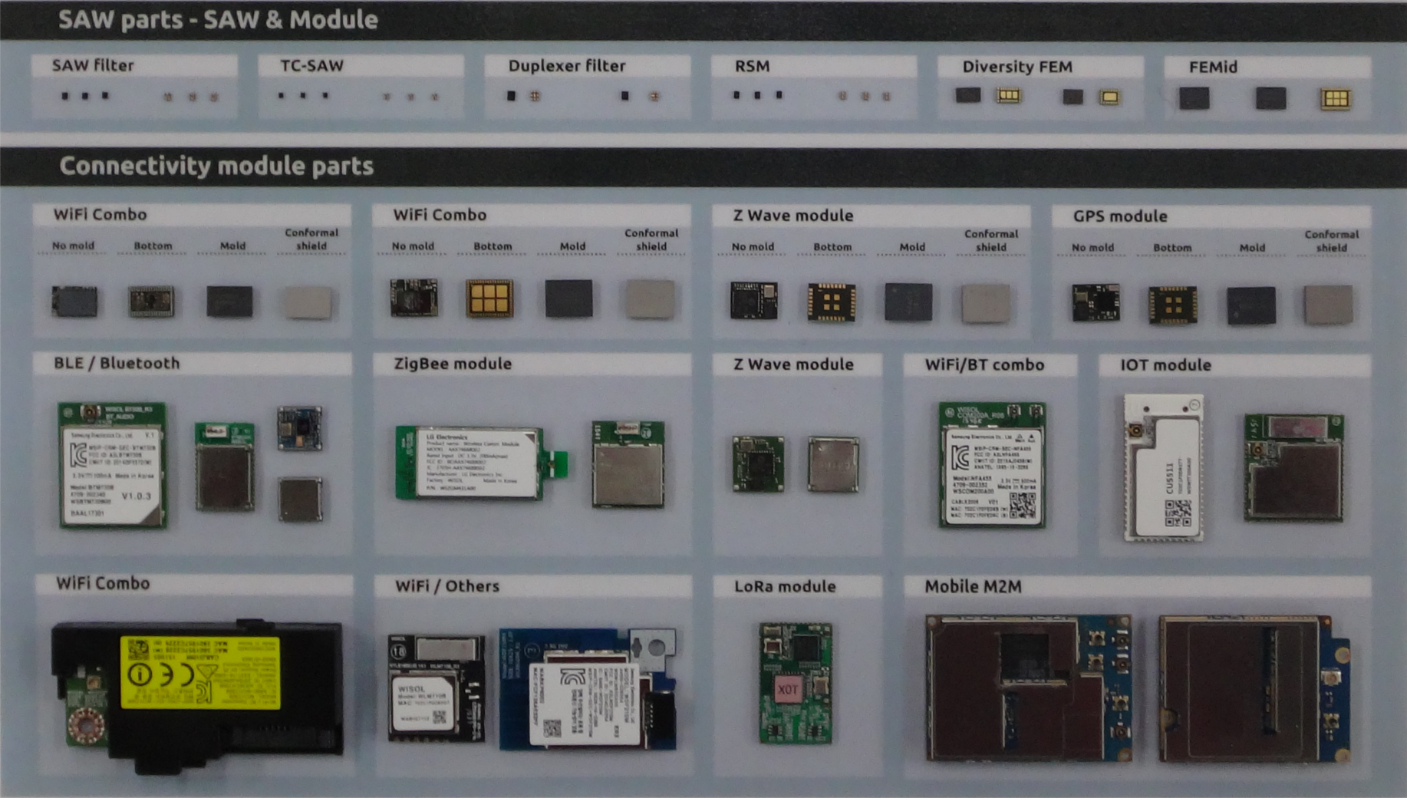
Product Portfolio

Slide 12
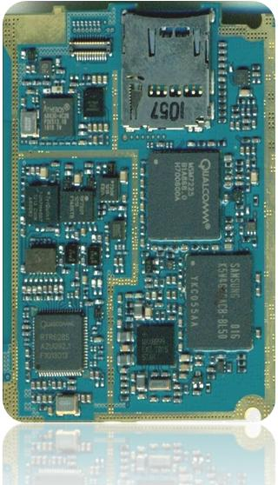
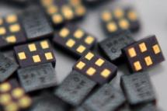

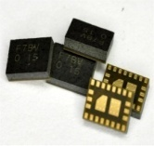
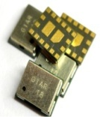
Product Portfolio
1. RF
SAW Filter
SAW Filter (Surface Acoustic Wave Filter)
Essential RF component selectively transmits certain frequency required for mobile communication system.
SAW Duplexer
Frequency separator for RX-TX
RF Component locating near of antenna of mobile phone dividing Receiving signal and sending signal.
It enables receiving and sending in one antenna.
Front End Module
Diversity FEM, GPS LNA Module, FEMiD
RF component making a packaging RF switch and
various SAW filters into one embedded plate with
electronic cells.

Slide 13
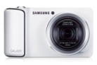
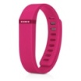
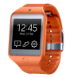
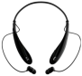
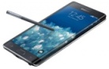
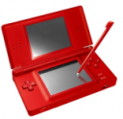
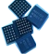
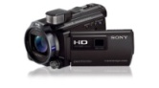
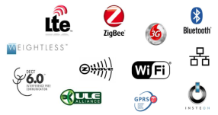





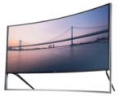
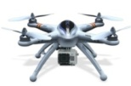
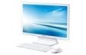
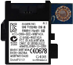
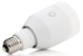
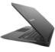
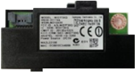
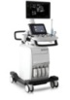


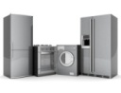
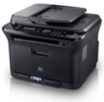
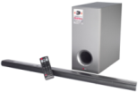
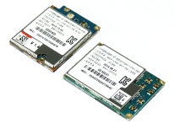

Product Portfolio
2. CM
SiP ( System in Package )
WISOL can support SiP ( System in Package )Type Modules
for small size devices, such as Mobile Phone, Digital Camera,
Digital Cam and Wearable devices.
PBA ( Printed Board Assembly )
WISOL can support All wireless solutions, such as
3G/LTE, Wi-Fi, Bluetooth, NFC, ZigBee, Z-wave to make a
connection in short-range with wireless solutions.
Always be a pioneer for new connectivity market;
Wearable and IoE with High Advanced wireless
Technology

Slide 14












Core Technology
1. Design Technology
- Simulation and CAE based design and development
- QCD innovation(High Quality, Low Cost, Best Delivery)
Material Stress analysis
RF Module
Actuator
Drop Stress analysis
Bonding
Soldering or bonding
[Modeling]
[Analysis]
[Design change]
[Development]

Slide 15

















Core Technology
2. Thin / Thick Process Technology
- Semiconductor Process (0.2um width, 3D wiring)
- Thick Film process (Screen printing, Baking, Plating)
- Bump Bonding, Real time Probing
Metal
Deposition
PR Coating
Exposure
(UV)
Etching
UBM
Deposition
Probe
Bump
Bonding
Thin
Film
Slip Casting
Screen Printing
Stacking
Laminate
Cutting
(pre-cut)
Sintering
Thick
Film

Slide 16
















Core Technology
3. Packaging Technology
Bonding ~ SMT
WLP
- SMT Technology(Wire/Flip Bonding, SMT)
- WLP (Wafer Level Packaging)
- Circuit Integrated Technology
Module
IC1
IC2
Wafer
Dicing
Flip
Bonding
Molding
Package
Dicing
Electrical
Test
Visual
Inspection
Pkg
Screen
Printing
Chip
Mounting
A.O.I
Solder
Reflow

Slide 17








Core Technology
4. Connectivity Module Design
Antenna design
Setup photo of DUT in chamber
Wi-Fi/BT Auto test Handler
RF Verify

Slide 18






















Core Technology
5. Physical analysis for R&D
- Wi-Center
- Fast Quality analysis
Scanning Electron Microscope
Microscope(x16~x17,280)
Cross-section
Polishing(for surface grinding)
De-capsulation
Solder open
Solder spreading
Solder crack
Cutting(for cross-section)
PCB Via defect
PCB Plating check
Preparation
(fixed sample)
2D – 3D X-RAY
Layer Polishing
Nondestructive inspection
(to inspect the Void delamination or Crack)
Solder spreading
Solder short
crack

Slide 19


Strong Point
1. Various Wireless Connectivity
We have various wireless solutions.
So, we can supply all kinds of modules as your request.

Slide 20





Strong Point
2. Cost
We have Saw, Duplexer and Front end Modules(GLM, Diversity FEM, FEMiD, SLM, DBLM) for mobile phone and Big customers in Korea and China(Samsung / LG / Oppo, BBK, TCL, Yulong, Lenovo, Meizu etc)
So, we can supply competitive price.
SAW Filters
Saw Duplexers
Front end Modules

Slide 21





























Strong Point
3. R&D
- Best Partner for IoT Devices
- Wide wireless experiences

Slide 22








www.wisol.co.kr
Social Contribution
Social Contribution of Voluntary participation and WISOL’s Matching Grant
Donations US$70,000/Year [ For Orphanage, Scholarships and etc ]

Slide 23

www.wisol.co.kr
Certification & Award

Slide 24
www.wisol.co.kr
THANKS !!

